Slide 1
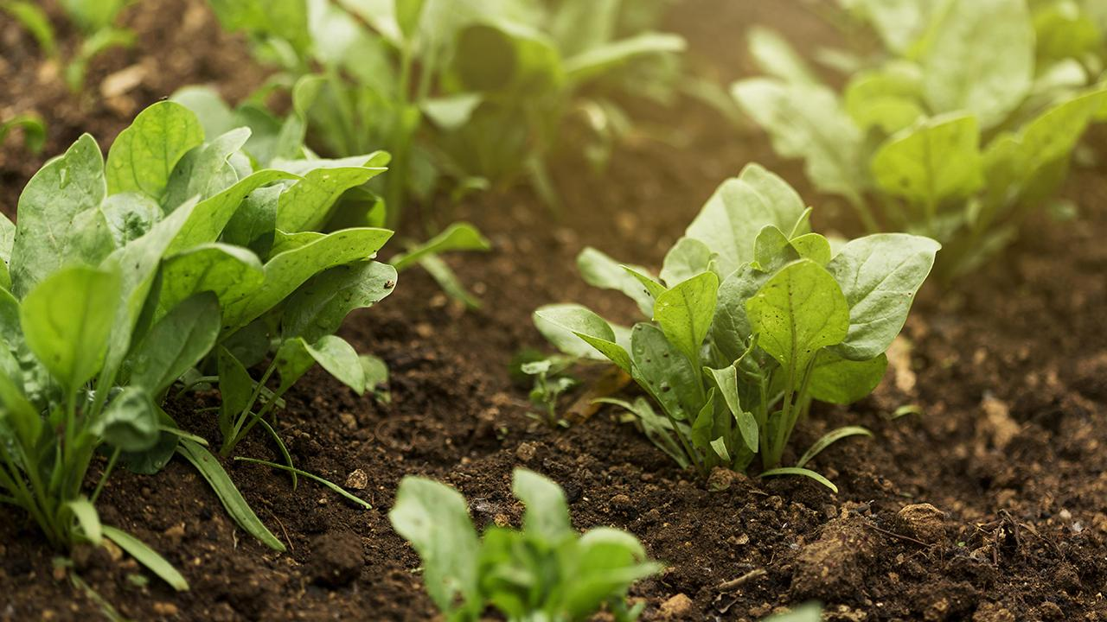
CROP SELECTION IN REAL-TIME USING SENSORS

Slide 2
Introduction:
1
Background
Real-time data is crucial in agriculture due to climate change and irregular weather patterns.
Focus
2
VIT Chennai's localized zones are ideal for university-driven agricultural research.
3
Objective
Create a decision-support system for accurate crop selection based on real-time, localized weather data.

Slide 3
Problem Statement :
The Challenge Farmers in VIT Chennai lack real-time, localized data, hindering informed crop selection. Traditional methods rely on outdated information, leading to inefficient resource use and increased crop failure risks. | The Solution Our Dynamic Crop Management System utilizes real-time environmental sensor data to provide microclimate-specific insights for optimized crop selection. | Key Features An AI-powered chatbot offers crop-related queries, combining sensor data with AI for an accessible, data-driven approach to sustainable agriculture.

Slide 4
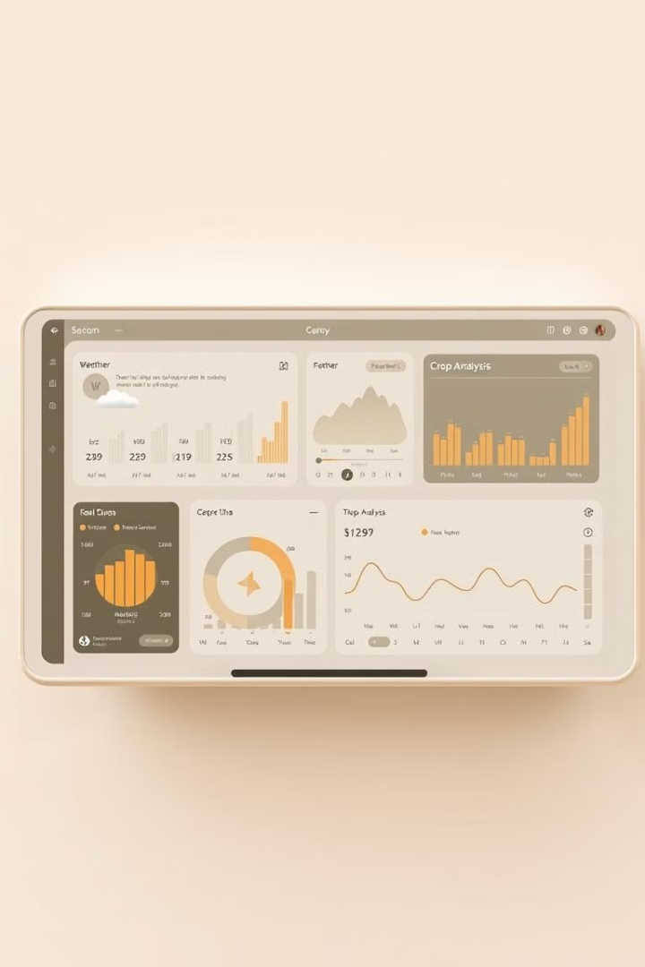
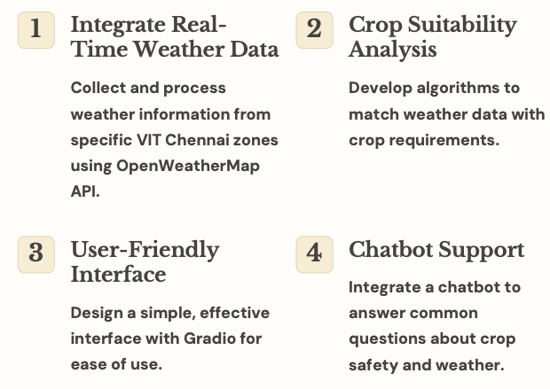
Research Objective :

Slide 5
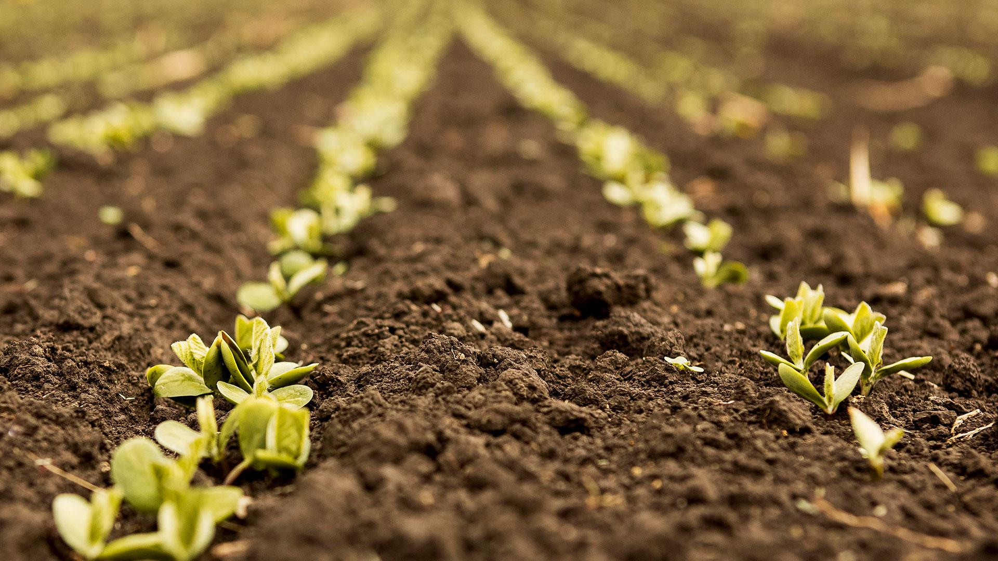


Slide 6
Proposed System Introduction :
Data Sources Weather data is retrieved in real-time from the OpenWeatherMap API, paired with predefined crop requirements data for suitability assessments. | Processing Pipeline The system collects and analyzes data, comparing real-time weather conditions with crop requirements to provide suitability recommendations on whether it is safe to grow a selected crop. | User Interface User interaction using Gradio, the UI includes a crop safety checker for real-time feedback and an AI-powered chatbot to answer crop and weather-related queries for various zones within VIT Chennai.

Slide 7
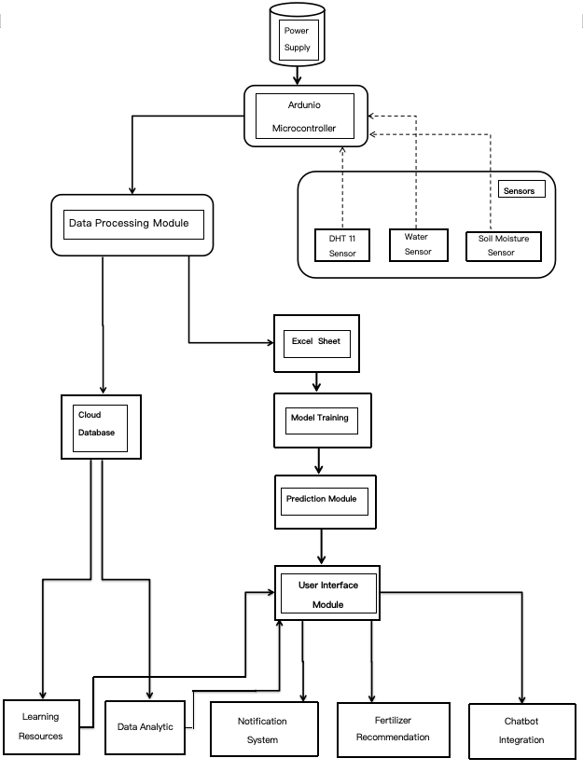
Proposed System Diagram :

Slide 8
Lists Of Modules :
1. Data Acquisition Module
- Collects data from various sensors (e.g., soil moisture, temperature, humidity, water intensity).
2. Data Processing Module
- Cleans and preprocesses the collected data for analysis.
- Handles data normalization and transformation.
3. Feature Extraction Module
- Identifies relevant features from the sensor data that influence crop selection.
4. Crop Prediction Module
- Utilizes machine learning algorithms to predict the best crop types based on the processed sensor data.
5. Decision Support System
- Provides recommendations for crop selection based on predictions and local conditions.
6. User Interface Module
- Allows users to interact with the system
7. Database Module
- Stores historical data, sensor readings, and crop performance records for future analysis.

Slide 9
8. Communication Module
- Facilitates communication between sensors and the central processing unit, possibly using IoT protocols.
09 Integration Module
- Integrates with external systems (like weather APIs) for enhanced data analysis.
10. Feedback Module
- Collects user feedback on recommendations for continuous improvement of the model.
11. Deployment Module
- Ensures that the application is deployed and operational in farming environments.

Slide 10
Explanation of all Modules :
Data Acquisition Module
Collects data from various sensors, including soil moisture, temperature, humidity, and light intensity. This module ensures real-time data collection critical for informed decision-making in agriculture.
Data Processing Module
Cleans and preprocesses the collected data. This includes handling missing values, normalizing data, and transforming raw data into a format suitable for analysis. It ensures that the data used for predictions is accurate and reliable.
Feature Extraction Module
Identifies key features from the sensor data that significantly impact crop selection, enabling the model to focus on the most relevant information.

Slide 11
Crop Prediction Module
Utilizes machine learning algorithms to predict the best crop types based on processed sensor data. It analyzes trends and patterns to provide accurate crop recommendations.
Decision Support System
Provides actionable insights and recommendations for crop selection based on predictions and local environmental conditions, enhancing the decision-making process for farmers.
User Interface Module
Allows users to interact with the system, view real-time data, receive alerts, and access crop recommendations through an intuitive interface.
Database Module
Stores historical data, sensor readings, and crop performance records. This information is vital for analyzing trends over time and improving future crop selections.

Slide 12
Communication Module
Facilitates the connection between sensors and the central processing unit, using IoT protocols such as MQTT or HTTP. This module ensures that data flows seamlessly from the field to the processing system, allowing for real-time analysis and response.
Integration Module
Integrates external systems and APIs, such as weather forecasts and market data, to enrich the decision-making process. By incorporating diverse data sources, this module enhances the model's accuracy and relevance, allowing users to make better-informed agricultural decisions.
Feedback Module
Collects user feedback on crop recommendations and system performance. This feedback is crucial for continuous improvement of the predictive model and user experience, allowing the system to adapt and evolve based on real-world usage.
Deployment Module
Ensures the application is effectively deployed in real-time farming environments. This module handles the logistics of system implementation, including user training, system maintenance, and troubleshooting to ensure ongoing operational efficiency.

Slide 13

Implementation

Slide 14
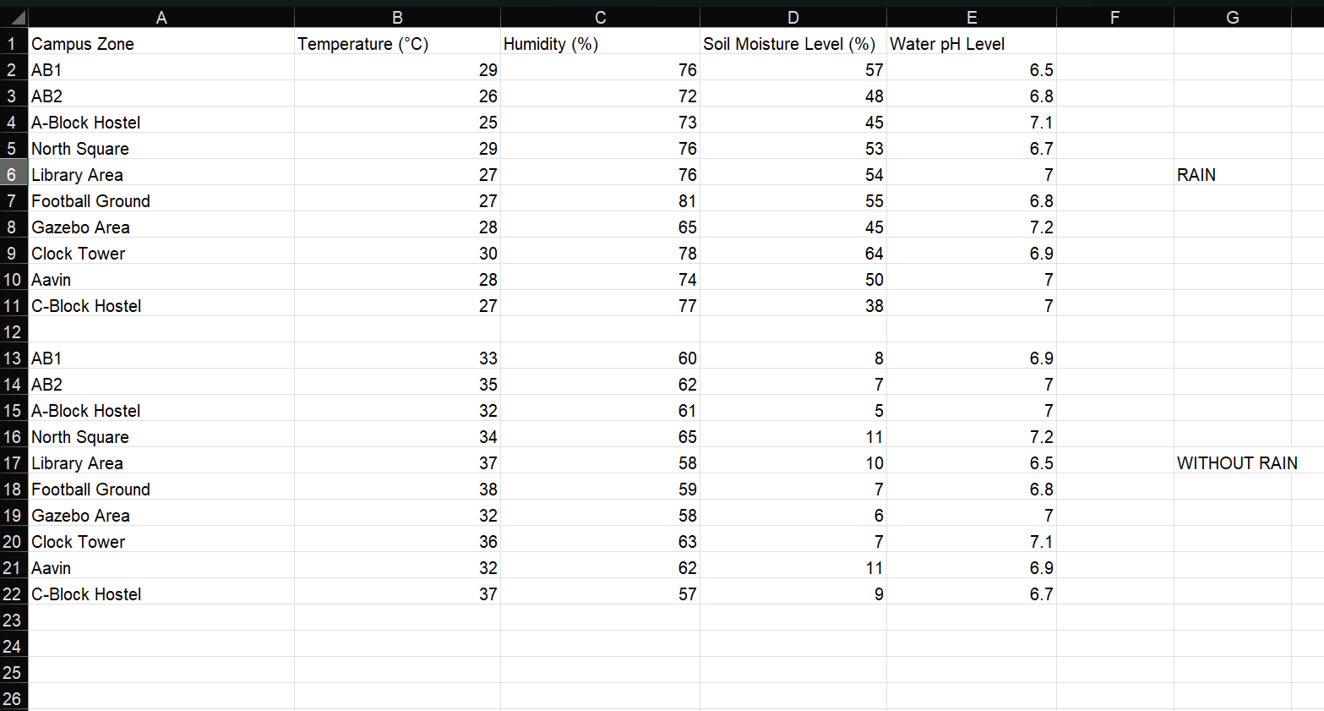
Excel Sheet :

Slide 15
Graphs :

Slide 16
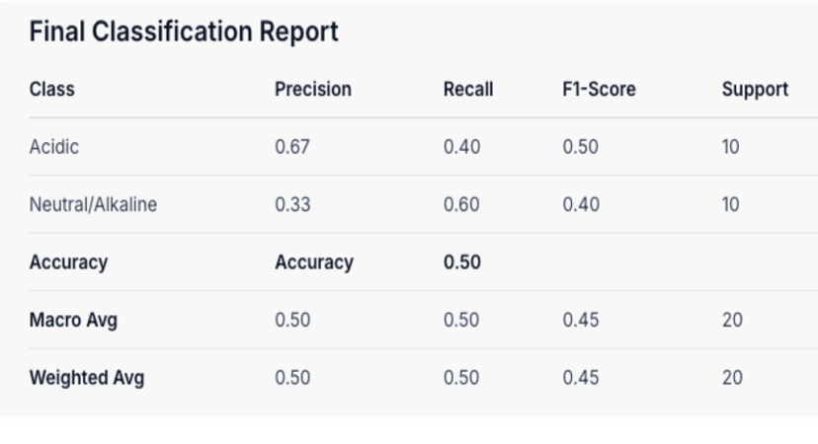
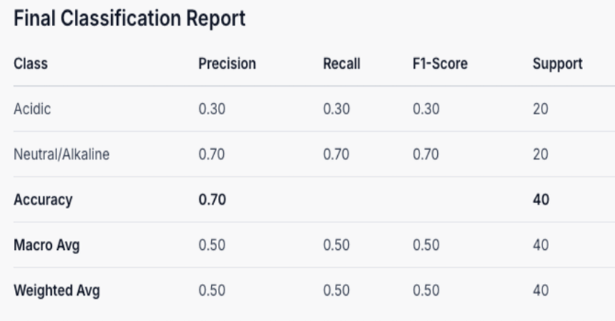
Classification Report (Before Rain vs After Rain)
BEFORE RAIN
AFTER RAIN

Slide 17
Equations :
1 ) Soil Moisture Content :
Soil Moisture Content (θ) = vw / v t × 100
θ = Soil moisture content (%)
​vw = Volume of water in the soil (m³)​
vt = Total volume of the soil sample (m³)
2) Relative Humidity :
Relative Humidity (RH) = e / es × 100
RH = Relative humidity (%)
e = Actual vapor pressure (hPa or mmHg).
es = Saturation vapor pressure (hPa or mmHg) at the same temperature.

Slide 18
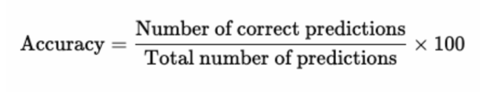
Water pH :
pH = - log10 (V/Vo)
V = Measured voltage
Vo = Reference voltage
Accuracy:

Slide 19
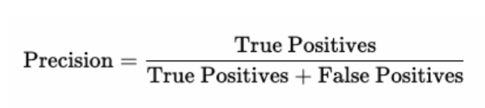
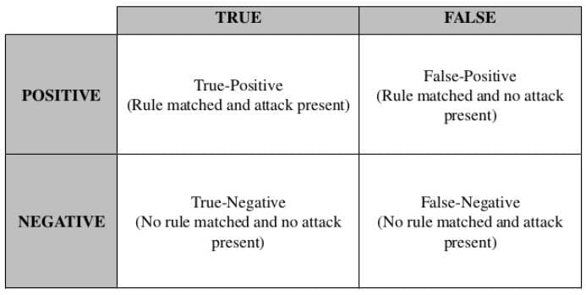
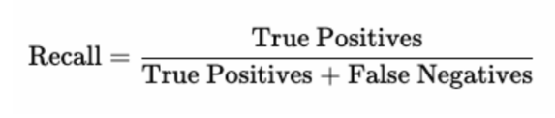
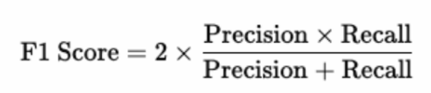
Precision:
Recall:
F1 Score:

Slide 20
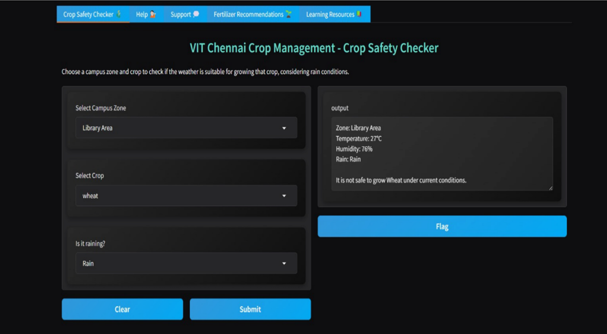
UI Interface:

Slide 21
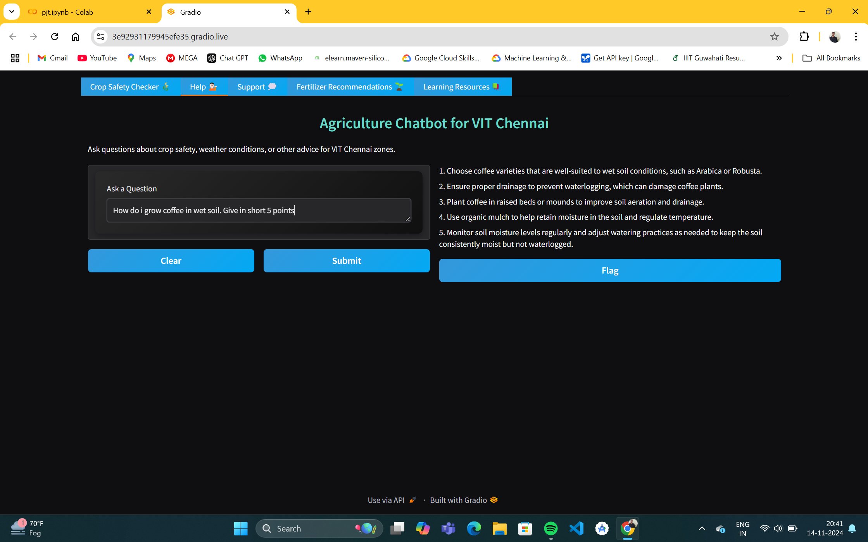
ChatBot for Farmers

Slide 22
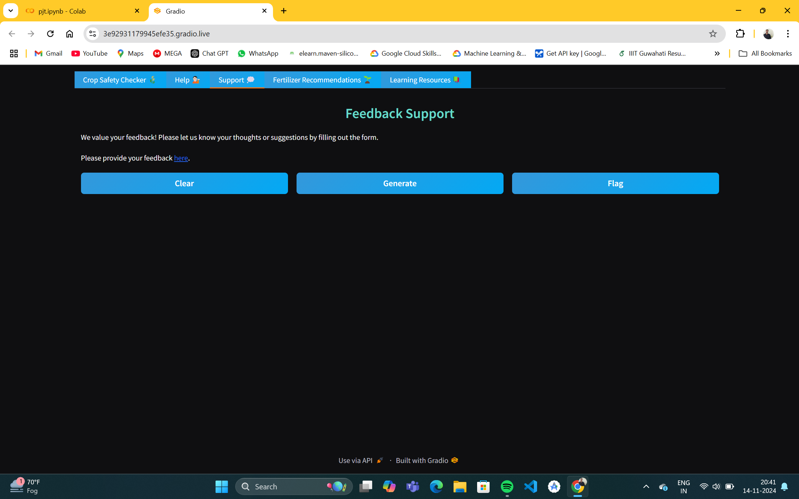

Feedback System

Slide 23
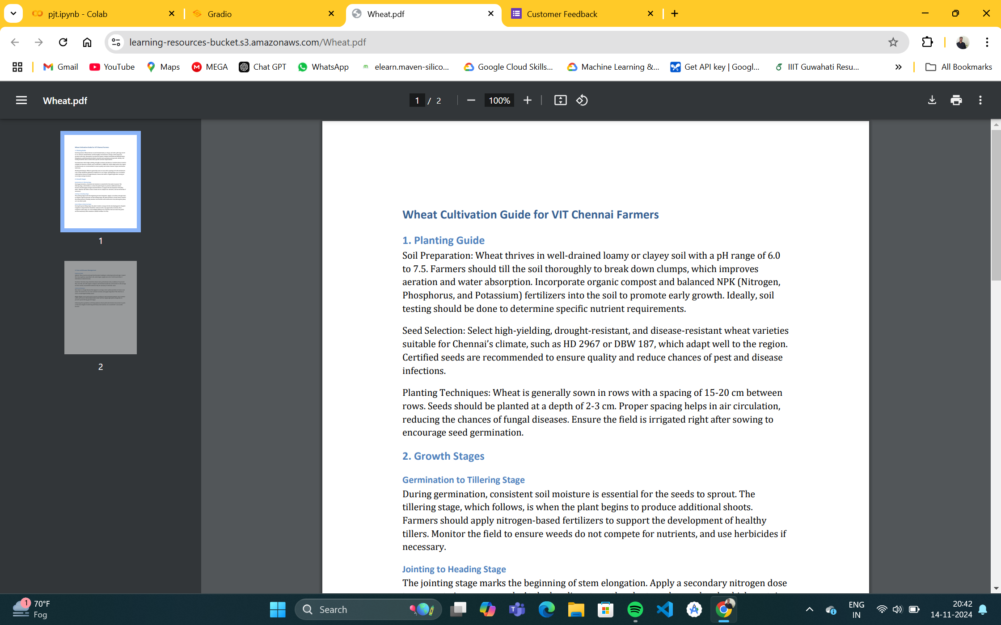
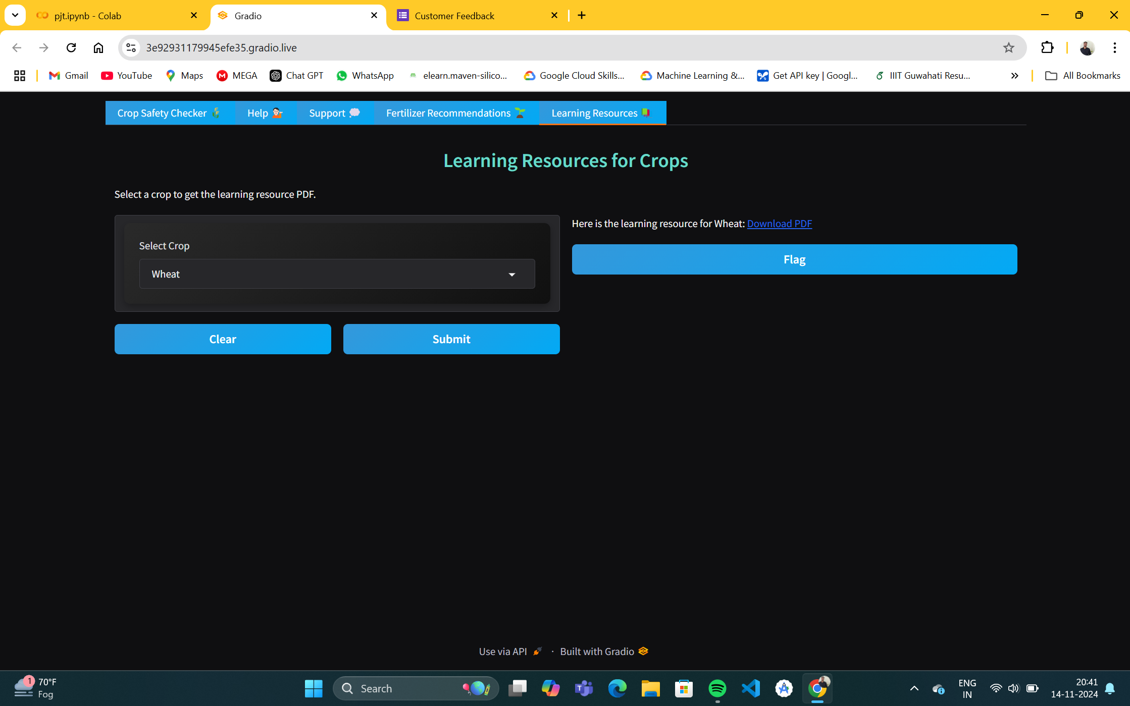
Learning Resources using Cloud

Slide 24
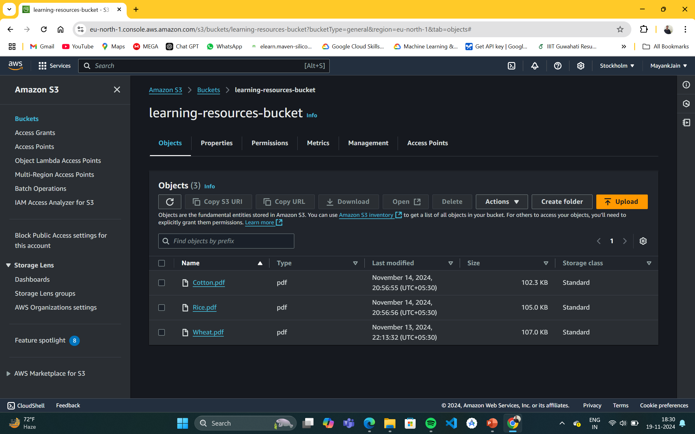
Cloud Integration using AWS S3

Slide 25
Findings and Observations :
Safety Analysis :
Consistent Crop Growth Zones : Zones such as AB1, Football Ground, and Gazebo Area meet the criteria for crops like wheat and rice due to stable temperature and moisture levels.
Challenging Zones : A-Block Hostel and North Square show fluctuating humidity, which may not suit crops requiring stable moisture.
Weather Impacts :
Humidity Observations : Zones like Library Area and D-Block Hostel have higher humidity, possibly influenced by campus vegetation.
Temperature Variability : AB2 and B-Block Hostel show lower temperature consistency, possibly affecting crops like cotton.
Preliminary Fertilizer Recommendations :
Nutrient Requirements: Initial data suggests high-nitrogen fertilizers for Library Area and North Square, aligning with higher crop nutrient demands.
Moisture-Sensitive Fertilizers: For zones like Football Ground and Gazebo Area, moisture-sensitive fertilizers are recommended due to varying moisture conditions.

Slide 26
Discussion :
Interpretation:
Support for Safe Crop Growth : This analysis demonstrates that specific campus zones at VIT Chennai have the environmental conditions conducive to growing various crops. By identifying these areas, farmers can make informed decisions that enhance crop yield while ensuring safety and sustainability.
Data-Driven Insights: The integration of weather metrics and fertilizer recommendations provides a holistic view, empowering farmers to optimize their agricultural practices.
Challenges:
Data Limitations : Challenges were encountered due to the lack of precise soil data, which hinders the ability to make definitive recommendations on crop suitability and fertilizer types.
Weather Inconsistencies : Inconsistencies in real-time weather data presented difficulties in maintaining updated assessments for specific zones, particularly in rapidly changing weather conditions.

Slide 27

Future Work

Slide 28
Future Recommendations:
Data Analytics :
Cloud integration enables real-time data collection and analysis from sensors and weather stations, providing insights like crop health, yield predictions, and pest alerts.
Enhanced Fertilizer Recommendations :
Data-driven, customized fertilizer recommendations based on soil and crop conditions help optimize yields and reduce waste.
Enhanced User Interface and Chatbot :
A cloud-enabled interface with an AI chatbot allows farmers to get instant answers to questions, access data, and receive farming advice in a user-friendly way.

Slide 29
References :
[1] D. K. Singh, A. Raj, and M. Sharma, “An IoT-Enabled Real-Time Crop Prediction System Using Soil Fertility Analysis,” MDPI Journal of Sensor Networks, vol. 12, no. 6, pp. 850-866, 2023.
[2] J. Park, L. Zhang, and K. Kim, “IoT-Enabled Soil Nutrient Analysis and Crop Recommendation Model for Precision Agriculture,” Sensors and Actuators B: Chemical, vol. 134, no. 2, pp. 512-530, 2022.
[3] H. S. Chen and M. W. Lee, “Cyber-Physical System Architecture Model in Precision Agriculture,” International Journal of Research and Analytical Reviews, vol. 10, no. 4, pp. 975-983, Nov. 2023.
[4] S. Rajeswari et al., “Smart Farming Prediction Using Machine Learning,” IEEE Conference on Artificial Intelligence and Agriculture, vol. 24, pp. 203-215, 2019.
[5] M. Khoury and R. Patel, “Precision Farming with IoT for Crop Health Monitoring,” IEEE Internet of Things Journal, vol. 7, no. 5, pp. 2214-2225, May 2020.

Slide 30
[6] P. Srivastava, R. Menon, and T. Zhao, “IoT-Based Soil Health Monitoring and Crop Recommendation,” Journal of Agricultural Informatics, vol. 15, no. 3, pp. 140-156, 2021.
[7] L. Wu and J. Chen, “Machine Learning and IoT for Real-Time Crop Selection,” Springer Proceedings in Smart Agriculture, vol. 9, pp. 131-142, 2022.
[8] T. Lee, P. Garcia, and S. Young, “AI and IoT in Precision Agriculture: Enhancing Crop Recommendation Systems,” IEEE Transactions on Agricultural Engineering, vol. 8, no. 3, pp. 335-345, 2022.
[9] R. Prasad and D. Kapoor, “Automated Crop Selection System Using IoT,” International Journal of Engineering Research & Technology, vol. 10, no. 2, pp. 76-88, 2021.
[10] X. Li et al., “Real-Time Crop Prediction and Monitoring Using IoT and ML,” IEEE Transactions on Internet of Things, vol. 13, pp. 221-235, 2023.

Slide 31
Thank You

